Slide 1
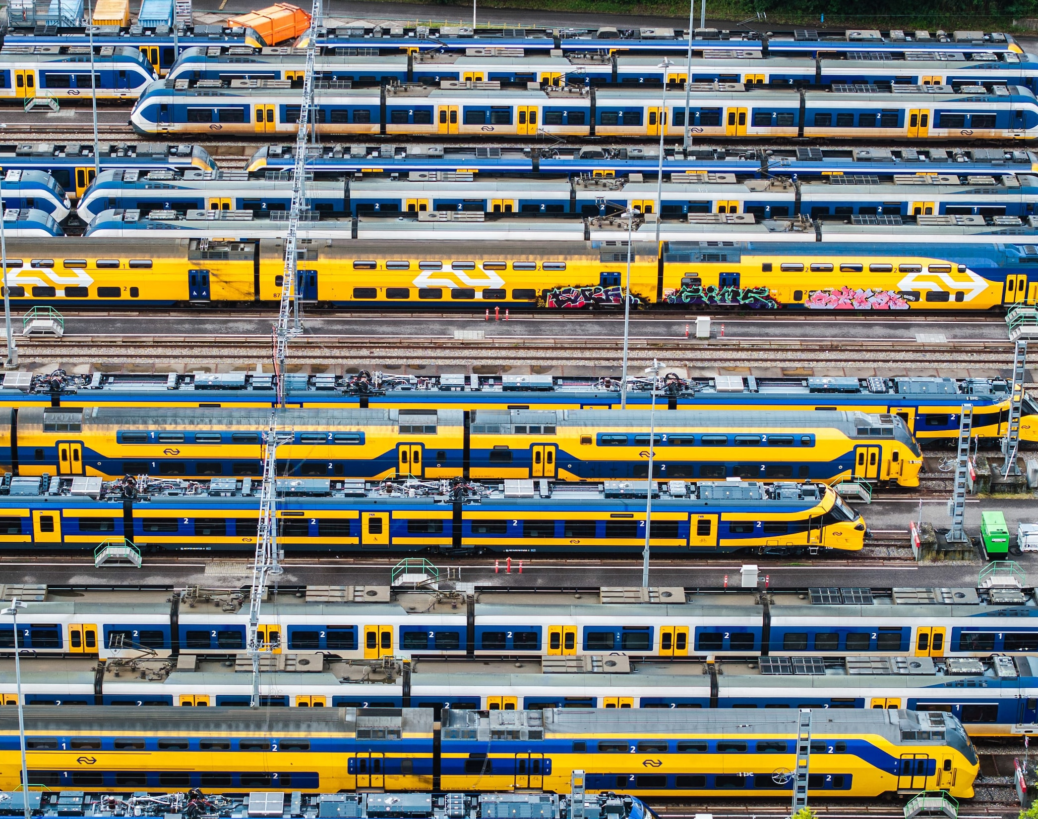
Train Delay Predictor

Slide 2
Right now, the NS app only shows if a train currently has any delays or not.
With this project I want to be able to predict if a train on a certain track will be more likely to be delayed or not.
My goal is to remove the annoyance of getting on the station and finding out your train is delayed for some time.
Notes:
Why?

Slide 3
Explainable AI
Definition of delay
What is being done
What kind of data do I need
Notes:
NS uses the European Punctuality Standard of 5 minutes delay
Multiple studies. None about more than 4 hour delay prediction.
Study from UTwente. suggests Historic train movements. This includes planned and real departure and arrival times
External factors and Weather

Slide 4
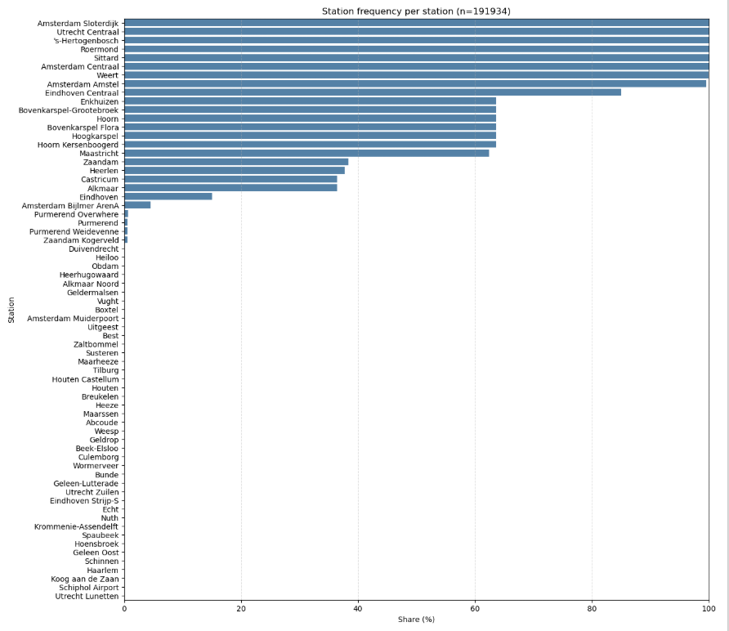
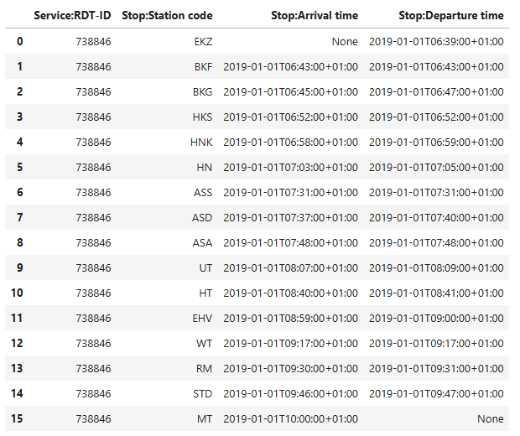
DAIA
Sittard & Eindhoven
Null Values
Non standard stations
Notes:
Januari 2019 – august 2025
Sorted the data so it would only include trains passing sittard and eindhoven
Null values, especially with Arrival and Departure time.
Found that there were a lot of non-standard stations in the dataset

Slide 5
Machine Learning
Feature engineering
RF, XGB, LGBM, DT
Notes:
Feature engineering.
Hour, Month, rush hour.

Slide 6
0 = Non-delayed
1 = Delayed
Model | Accuracy | Precision 0 - 1 | Recall 0 - 1 | F1 0 - 1
Random Forest | 0.957 | 1.000 – 0.368 | 0.957 – 0.992 | 0.978 – 0.536
XGBoost | 0.957 | 1.000 – 0.366 | 0.956 – 1.000 | 0.977 – 0.536
LightGBM | 0.957 | 1.000 – 0.366 | 0.956 – 1.000 | 0.977 – 0.536
Decision Tree | 0.957 | 1.000 – 0.366 | 0.956 – 1.000 | 0.977 – 0.536
Notes:
Results, which display a lack of proper feature engineering.

Slide 7
Reflection
More thorough data analysis
Domain Understanding
Notes:
Poor data analysis.
Better domain understanding would have helped

Slide 8
Train Delay Predictor

